Slide 1
HR Analytics
Final DEPI Project Presentation

Slide 2
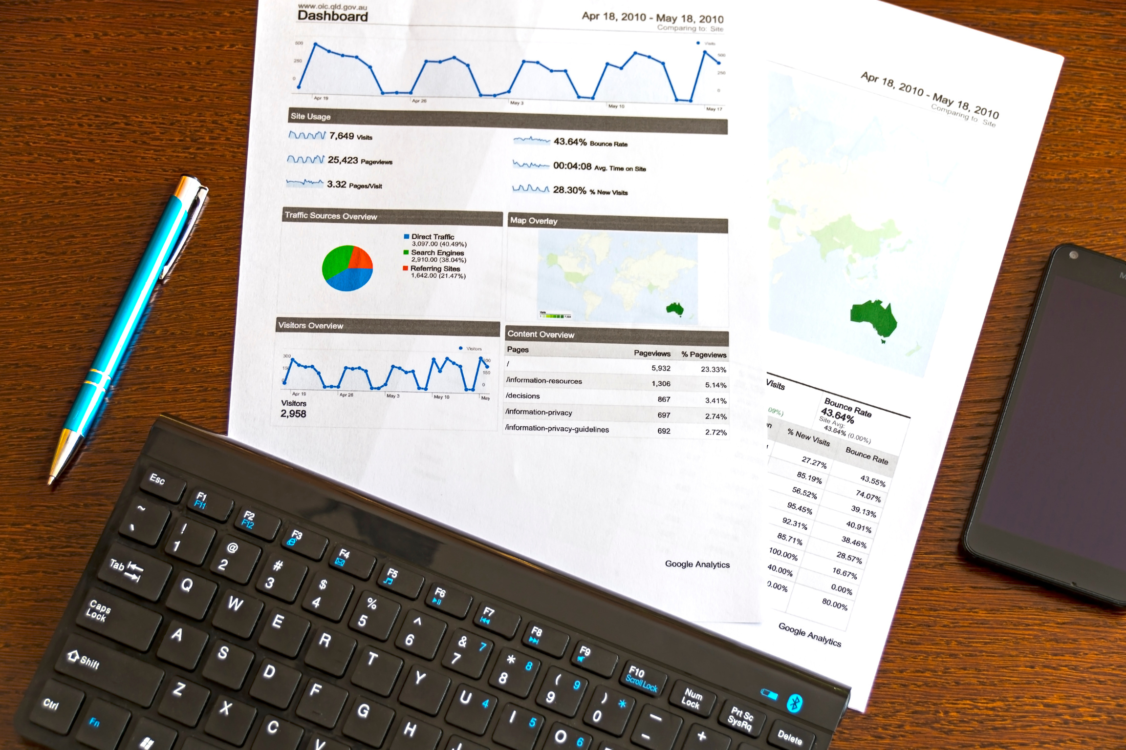
About Us
  Kareem: Team Leader & Coordinator, Data collection, Dashboard Design, and task management.
  Arsany: Data Cleaning & Modeling
  Abdullah: Workforce Overview + its DAX, documentation, and PPT
  George: Demographic Overview + its DAX
  Youssef: Attrition Overview + its DAX

Slide 3
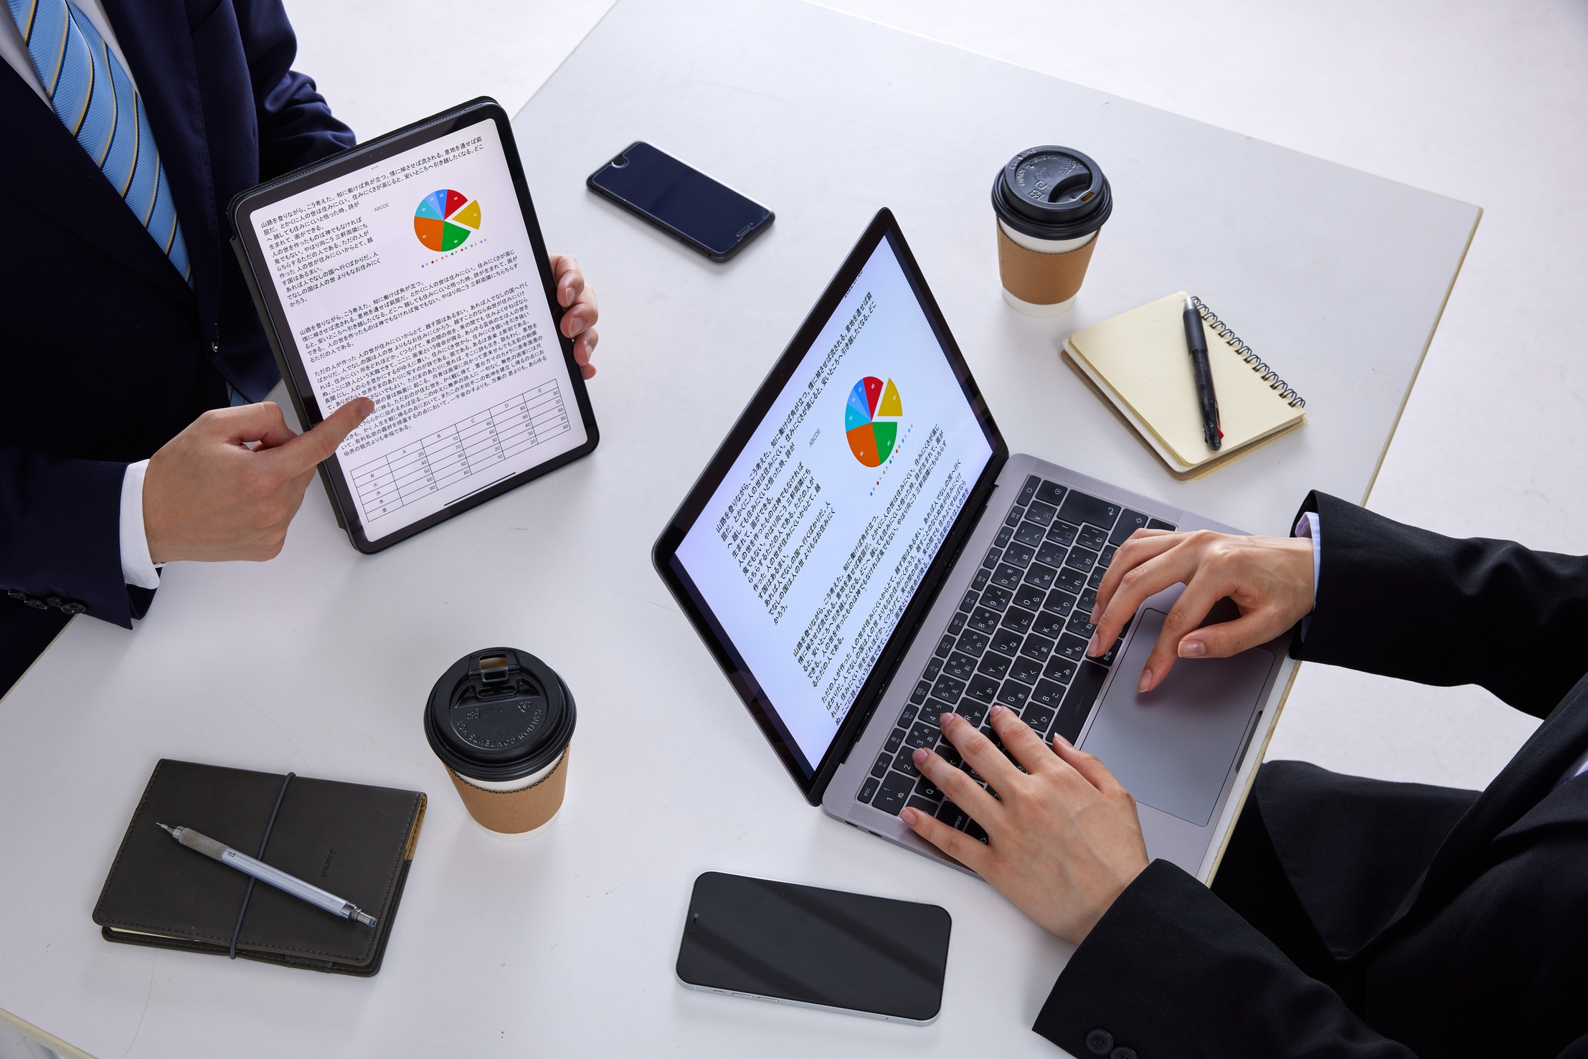
Introduction
In today's business world, a company's greatest asset isn't its capital or its products; it's its people. But the real question is: Do leaders have a clear, real-time view of how these assets move, what they cost, and why they leave? That is where our project comes in, turning scattered HR data into a powerful storytelling tool for better decision-making.

Slide 4
Dashboard Contains 3-page
01
Workforce Overview
02
Demographic Overview
03
Attrition Overview

Slide 5
Data Modeling

Slide 6
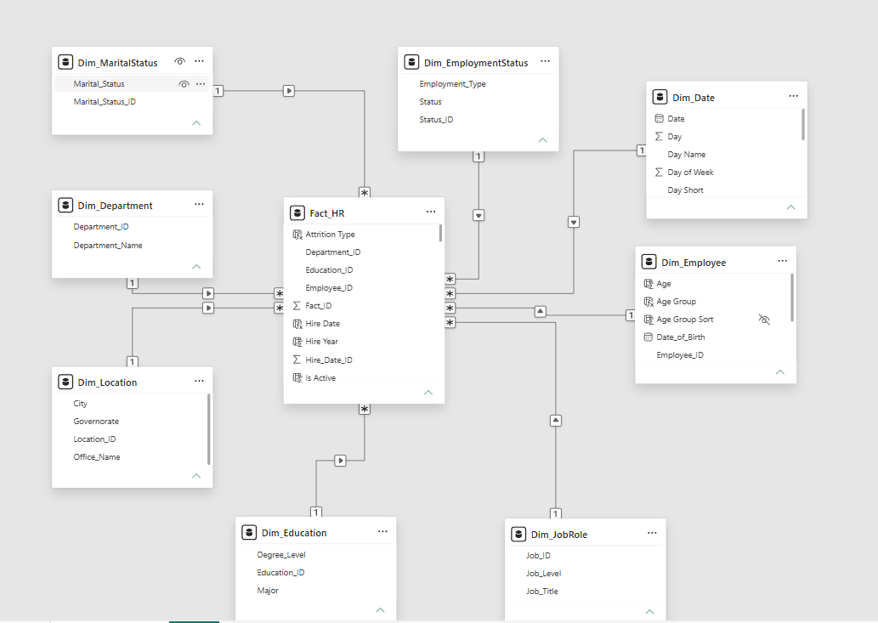

Slide 7
1st Page
Workforce Overview

Slide 8
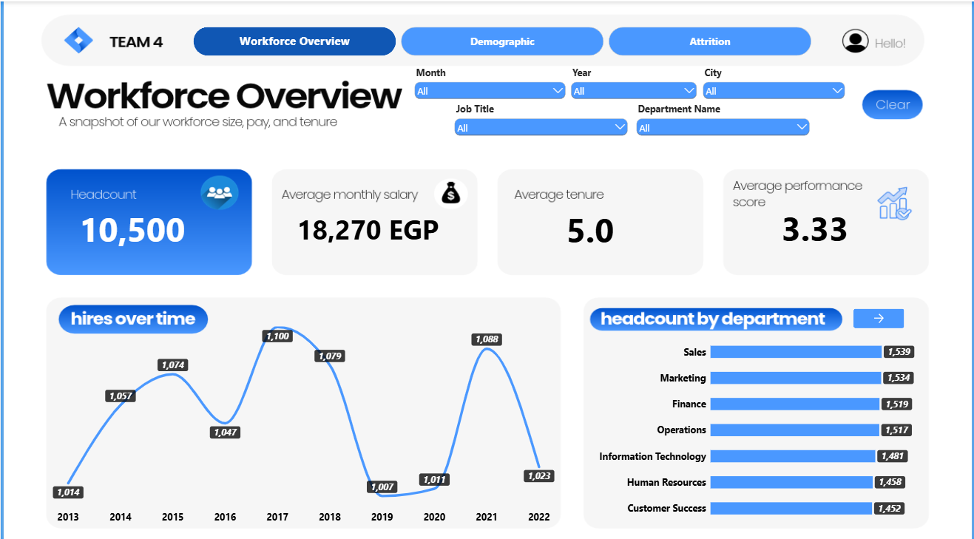

Slide 9
2nd Page
Demographic Overview

Slide 10
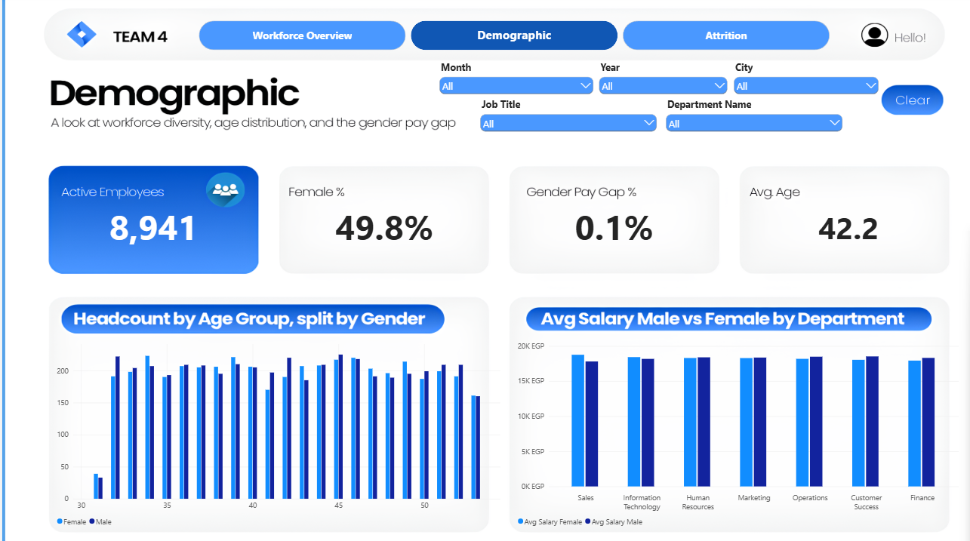

Slide 11
3rd Page
Attrition Overview

Slide 12
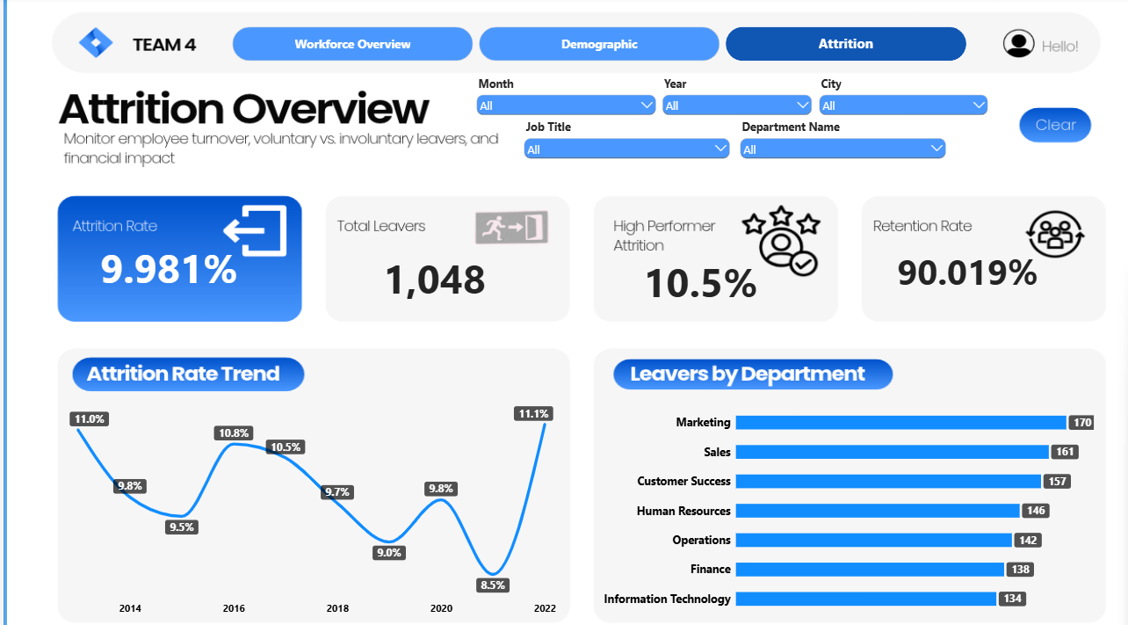

Slide 13
Conclusion
  The Challenge Solved: Successfully eliminated slow, error-prone manual spreadsheets by centralizing workforce data into a robust, automated Power BI semantic model.
  Comprehensive 360° Visibility: Delivered an intuitive, interactive three-page dashboard that bridges the gap between different stakeholders—empowering HR and executive leadership with real-time insights into headcount, payroll, demographics, and attrition drivers.
  Actionable Business Value: Standardized critical KPI metrics to shift the organization from reactive reporting to proactive retention strategies, pay-equity monitoring, and optimized workforce management.
  Future-Ready Roadmap: Established a scalable foundation for advanced analytics, laying the groundwork for predictive turnover modeling and continuous organizational excellence.

Slide 14
Thank
You
Questions & Discussion

